Slide 1
Chapter 10
Age of Exploration

Slide 2
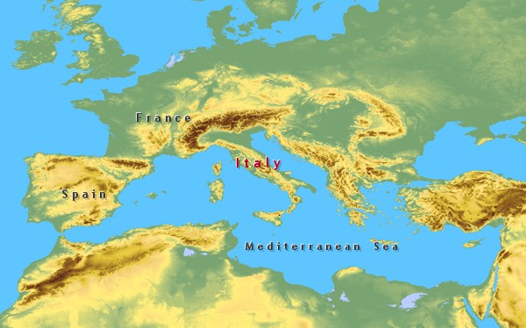

Slide 3
A. ADVANCEMENTS IN TECHNOLOGY
-ADVANCES IN TECHNOLOGY HELPED MAKE THE EUROPEAN VOYAGES OF EXPLORATION POSSIBLE.
(1) MAPMAKERS DREW MORE ACCURATE LAND AND
SEA MAPS
(2) USE OF THE ASTROLABE, AN INSTRUMENT THAT
MEASURED THE POSITIONS OF THE STARS
WHICH HELPED SAILORS FIGURE OUT THEIR
LATITUDE AT SEA
(3) EUROPEAN SAILORS USED THE MAGNETIC
COMPASS INVENTED BY THE CHINESE TO
DETERMINE THEIR DIRECTION
(4) BIGGER SHIPS THAT COULD CARRY MORE
CARGO AND WITHSTAND ROUGHER SEAS OF
OCEANS
(5) LARGER SIZE AND DIFFERENT SHAPED SAILS
ALLOWED SHIPS TO TRAVEL FASTER

Slide 4
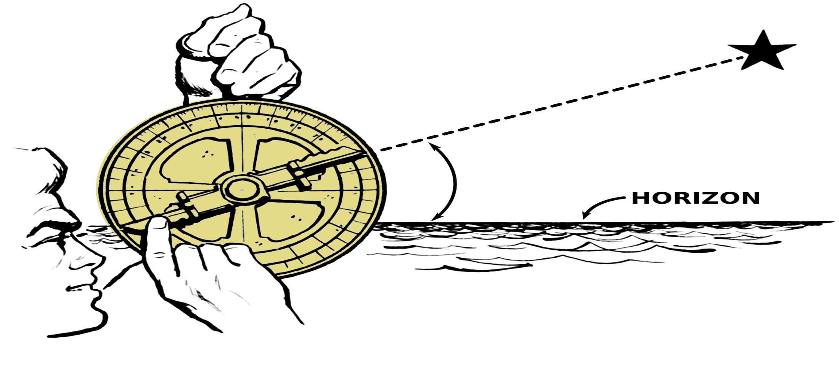
THE ASTROLABE

Slide 5
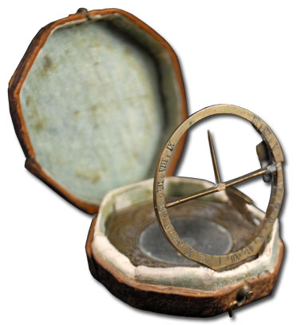
THE MAGNETIC COMPASS

Slide 6
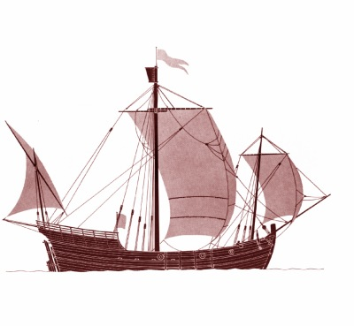
Portuguese Caravels

Slide 7
B. EARLY EXPLORATION
- PORTUGAL LED THE WAY IN EARLIER VOYAGES OF EXPLORATION IN ORDER TO COMPETE WITH OTHER WESTERN EUROPEAN COUNTRIES TO GET NEEDED SUPPLIES FROM THE EAST.
-MOST EARLY TRADE TO EUROPE WAS CARRIED OVER LAND BY ARAB MERCHANTS TO PORTS IN THE EASTERN MEDITERRANEAN SEA WHICH THEN ITALIAN SHIP CARRIED GOODS ACROSS THE MEDITERRANEAN TO EUROPE.
-BECAUSE THESE GOODS PASSED THROUGH VARIOUS MERCHANTS TO GET TO THE WESTERN EUROPEAN COUNTRIES, PORTUGAL PAID INFLATED PRICES FOR THESE GOODS.
-PORTUGUESE MONARCHS’ EAGER TO IMPROVE THE NATION’S WEALTH AND STATUS ( BY GETTING THIS GOODS AT A REDUCED PRICE) WANTED TO GET A SHARE OF THE RICH SPICE TRADE TO ASIA
- THE ONLY WAY TO DO THIS WAS TO BYPASS THE ARAB AND ITALIAN MERCHANTS AND CREATE THEIR OWN DIRECT TRADE ROUTE TO ASIA.

Slide 8
B. PORTUGUESE EXPLORATION
1. PRINCE HENRY THE NAVIGATOR
-PRINCE HENRY, KNOWN PRINCE HENRY THE NAVIGATOR, ENCOURAGED THE EARLY PORTUGUESE EXPLORATIONS.
-HE BROUGHT TOGETHER ASTRONOMERS, GEOGRAPHERS AND MATHEMATICIANS TO SHARE THEIR LEARNING WITH PORTUGUESE SAILORS.
-THE PORTUGUESE BEGAN SETTING UP TRADING STATIONS ALONG THE WEST AFRICAN COAST TO TRADE FOR GOLD AND IVORY.

Slide 9
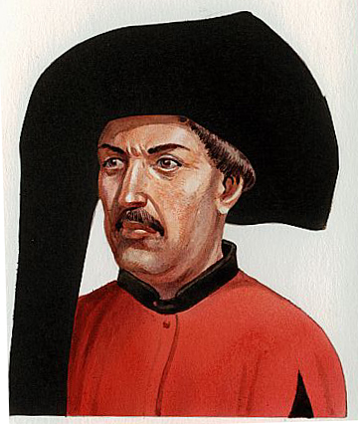

Slide 10
B. PORTUGUESE TRADE (Pg.2)
2. BARTHOLOMEU DIAS
-IN 1481, KING JOHN II OF PORTUGAL WANTED TO FIND A DIRECT ALL-WATER TRADE ROUTE AROUND AFRICA THAT WOULD ALLOW PORTUGAL TO TRADE WITH INDIA AND CHINA.
-IN 1488, BARTHOLOMEU DIAS ROUNDED THE SOUTHERN TIP OF AFRICA.
-THE SOUTHERN TIP BECAME KNOWN AS THE CAPE OF GOOD HOPE BECAUSE IT WOULD BE THE DIRECT ROUTE TO INDIA THAT THEY NEEDED.

Slide 11
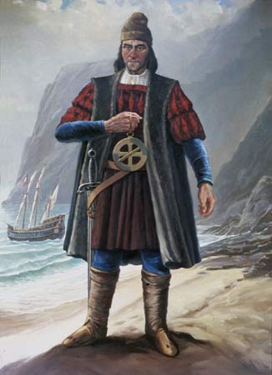
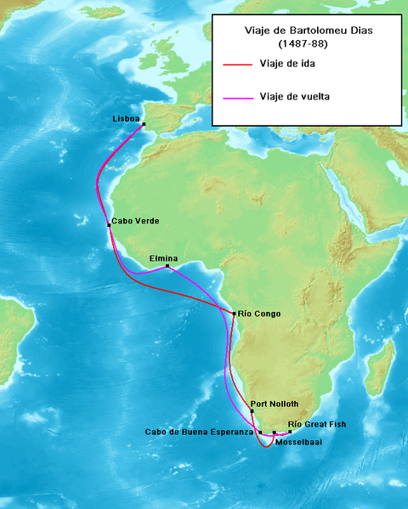

Slide 12
B. PORTUGUESE TRADE (Pg.3)
3. VASCO DA GAMA
-IN 1497-1498, VASCO DA GAMA ROUNDED THE CAPE OF GOOD HOPE, EXPLORED CITIES ON THE EAST AFRICAN COAST AND FINALLY REACHED INDIA.
-AS A RESULT, PORTUGAL GAINED A MONOPOLY ON THE SEA TRADE ROUTES FROM EUROPE TO INDIA FOR OVER A CENTURY.

Slide 13
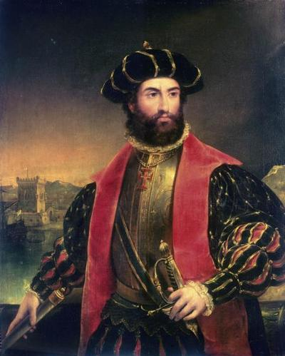
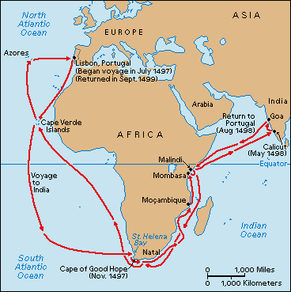

Slide 14
C. SPANISH EXPLORATIONS
-STARTING IN THE 700S, SPANISH MONARCHS BEGAN TO UNITE SPAIN UNDER CHRISTIAN CONTROL BY CONQUERING MUSLIM STRONGHOLDS IN SOUTHERN SPAIN AND ESTABLISHING THE ROMAN CATHOLIC CHURCH AS THE DOMINANT FORM OF RELIGION IN SPAIN.
(KNOWN AS THE RECONQUISTA)
- THE RECONQUISTA CULMINATED WITH THE MARRIAGE OF FERDINAND OF ARAGON AND ISABELLA OF CASTILLE IN 1469 BROUGHT TWO OF THE MOST POWERFUL SPANISH KINGDOMS.
-TO UNIFY SPAIN UNDER COMPLETE CHRISTIAN CONTROL, QUEEN ISABELLA AND KING FERDINAND MADE USE OF THE INQUISITION.
-THE INQUISITION WAS A BRUTAL CAMPAIGN TO SUPPRESS HERESY ( NON-CHRISTIAN BELIEVERS).
-NON-CHRISTIANS WERE EITHER KILLED OR FORCED INTO EXILE
-AFTER UNIFYING THE COUNTRY UNDER CHRISTIANITY, SPAIN WAS NOW FREE TO TURN THEIR ATTENTION TO FINDING A DIRECT TRADE ROUTE TO ASIA IN ORDER TO COMPETE WITH PORTUGAL.

Slide 15
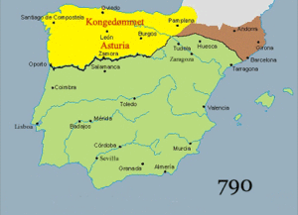

Slide 16
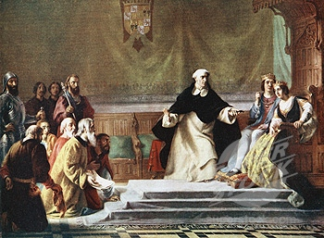

Slide 17
1) CHRISTOPHER COLUMBUS
- A SEA CAPTAIN FROM GENOA, CONVINCED FERDINAND AND ISABELLA TO SPONSOR A VOYAGE TO ASIA WESTWARD ACROSS THE ATLANTIC OCEAN.
- IN THE 1400S, THERE WERE CONFLICTING THEORIES ON SIZE ON EARTH. COLUMBUS BELIEVED THAT A WESTWARD JOURNEY TO ASIA WOULD TAKE BETWEEN TWO AND FOUR MONTHS.
-QUEEN ISABELLA FINALLY AGREED TO SPONSOR THE VOYAGE ON AUGUST 3, 1492,
-THREE SMALL SHIPS (THE NINA, THE PINTA AND THE SANTA MARIA) LEFT SPAIN IN SEARCH OF A WESTWARD ROUTE TO INDIA.
-ON OCTOBER 12, THEY FINALLY REACHED LAND. COLUMBUS WAS CONVINCED THAT THEY LANDED IN THE EAST INDIA (SERIES OF ISLAND CHAINS IN SOUTHEAST ASIA),
-COLUMBUS CALLED THE NATIVES “INDIANS” DUE TO THE BELIEF OF WHERE HE LANDED
-IN THREE MORE VOYAGES, COLUMBUS EXPLORED THE VARIOUS CARIBBEAN ISLANDS.
-HIS EXPLORATIONS OPENED THE WAY FOR SPAIN TO COLONIZE TWO HUGE CONTINENTS, NORTH AND SOUTH AMERICA.

Slide 18
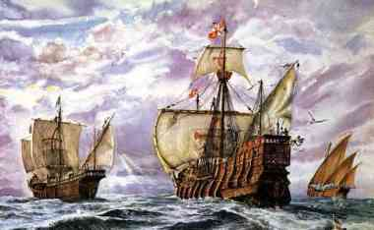

Slide 19
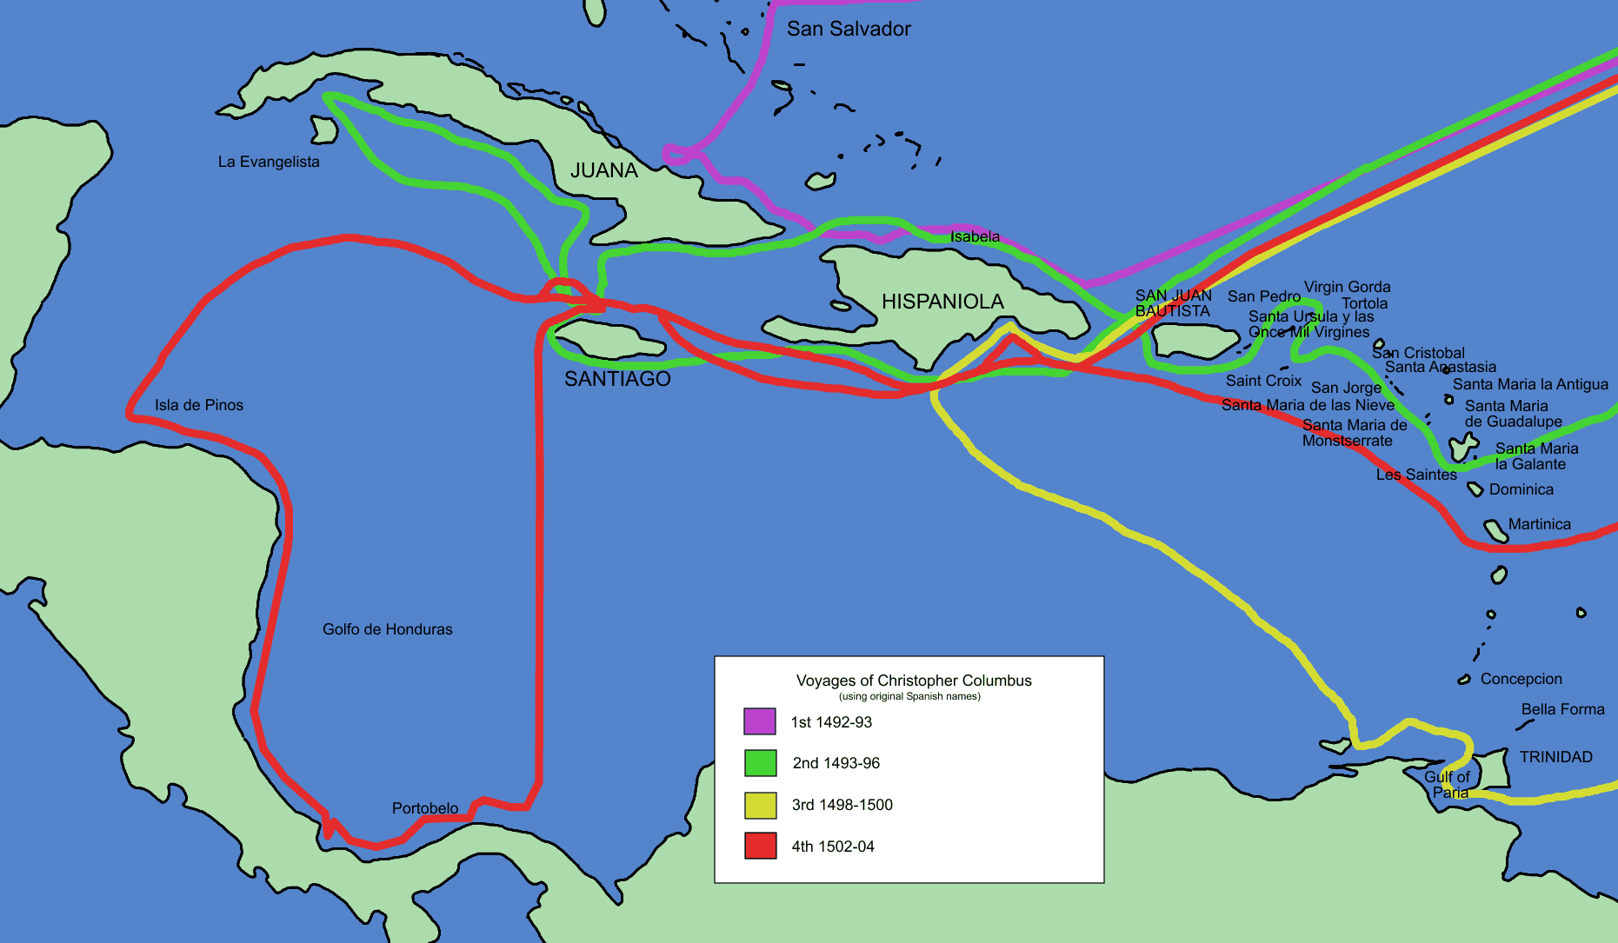

Slide 20
D. MESOAMERICA CULTURES
-CIVILIZATIONS BEGAN TO FLOURISH IN THE AMERICAS IN A REGION CALLED MESOAMERICA. MESOAMERICA OR MIDDLE AMERICA IS AN AREA THAT STRETCHED FROM CENTRAL AMERICA TO SOUTH AMERICA.
OLMECS
-SETTLED IN SOUTHERN MEXICO, THE OLMEC CIVILIZATION BUILT ONE OF THE EARLIEST CIVILIZATIONS IN THE AMERICAS.
-BY 1200 BC, THE OLMEC HAD LARGE PLANNED CITIES THAT SERVED AS RELIGIOUS CENTERS.
-AROUND 400 BC, THE OLMEC CIVILIZATION GRADUALLY DECLINED.

Slide 21
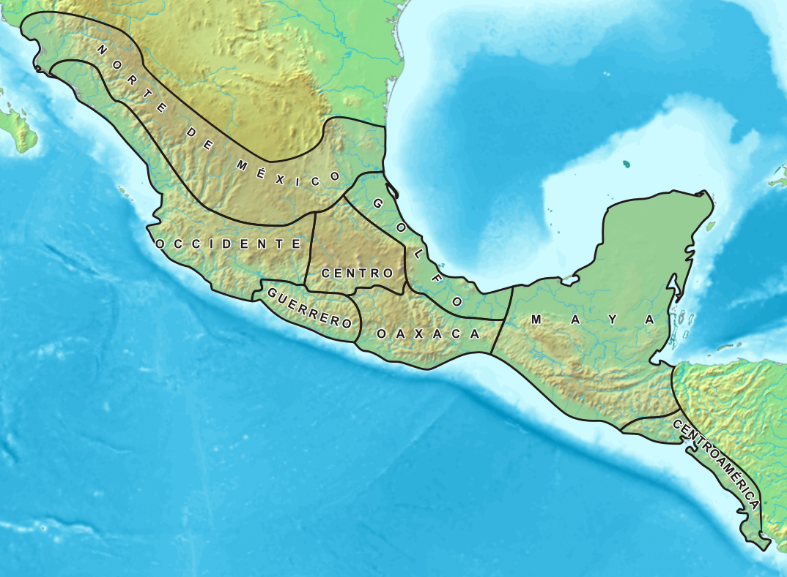

Slide 22
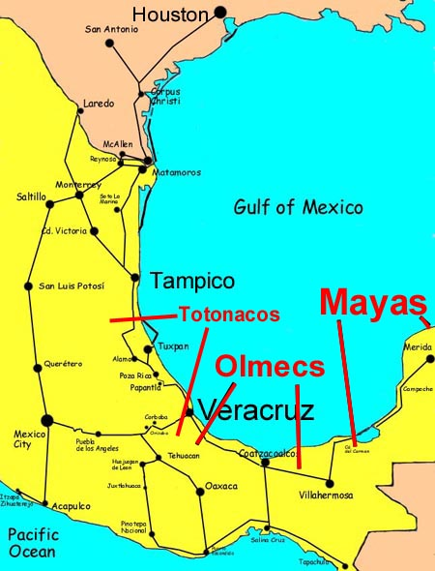

Slide 23
D. MESOAMERICAN CULTURES
2) MAYANS
-THE MAYAN CIVILIZATION SETTLED IN THE TROPICAL LOWLANDS OF THE YUCATAN PENINSULA IN SOUTHERN MEXICO.
-THE MAYAN CIVILIZATION GRADUALLY TOOK CONTROL OF ALL OF CENTRAL AMERICA FROM 250-900 CE.
-MAYAN CITIES WERE CHIEFLY RELIGIOUS CENTERS WITH AN IMMENSE PYRAMID AT THE CENTER OF THE EACH CITY-STATE.
-PRIESTS AND WARRIOR NOBLES MADE UP A POWERFUL RULING CLASS
-THE MAYANS CLEARED DENSE RAIN FORESTS, BUILT ELABORATE IRRIGATION SYSTEMS AND ORGANIZED INDEPENDENT CITY-STATES
-THE MAYANS DEVELOPED A TWO CALENDARS, ONE BASED ON THEIR RELIGION AND THE SECOND BASED ON THE SUN
-BY THE LATE 800S CE, THE MAYAN CIVILIZATION BEGAN TO DECLINE AND NORTHERN INVADERS BEGAN TO TAKE OTHER THEIR LANDS

Slide 24
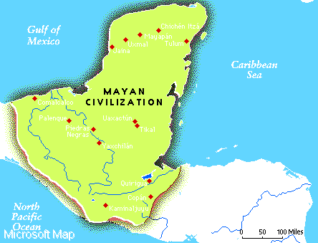

Slide 25
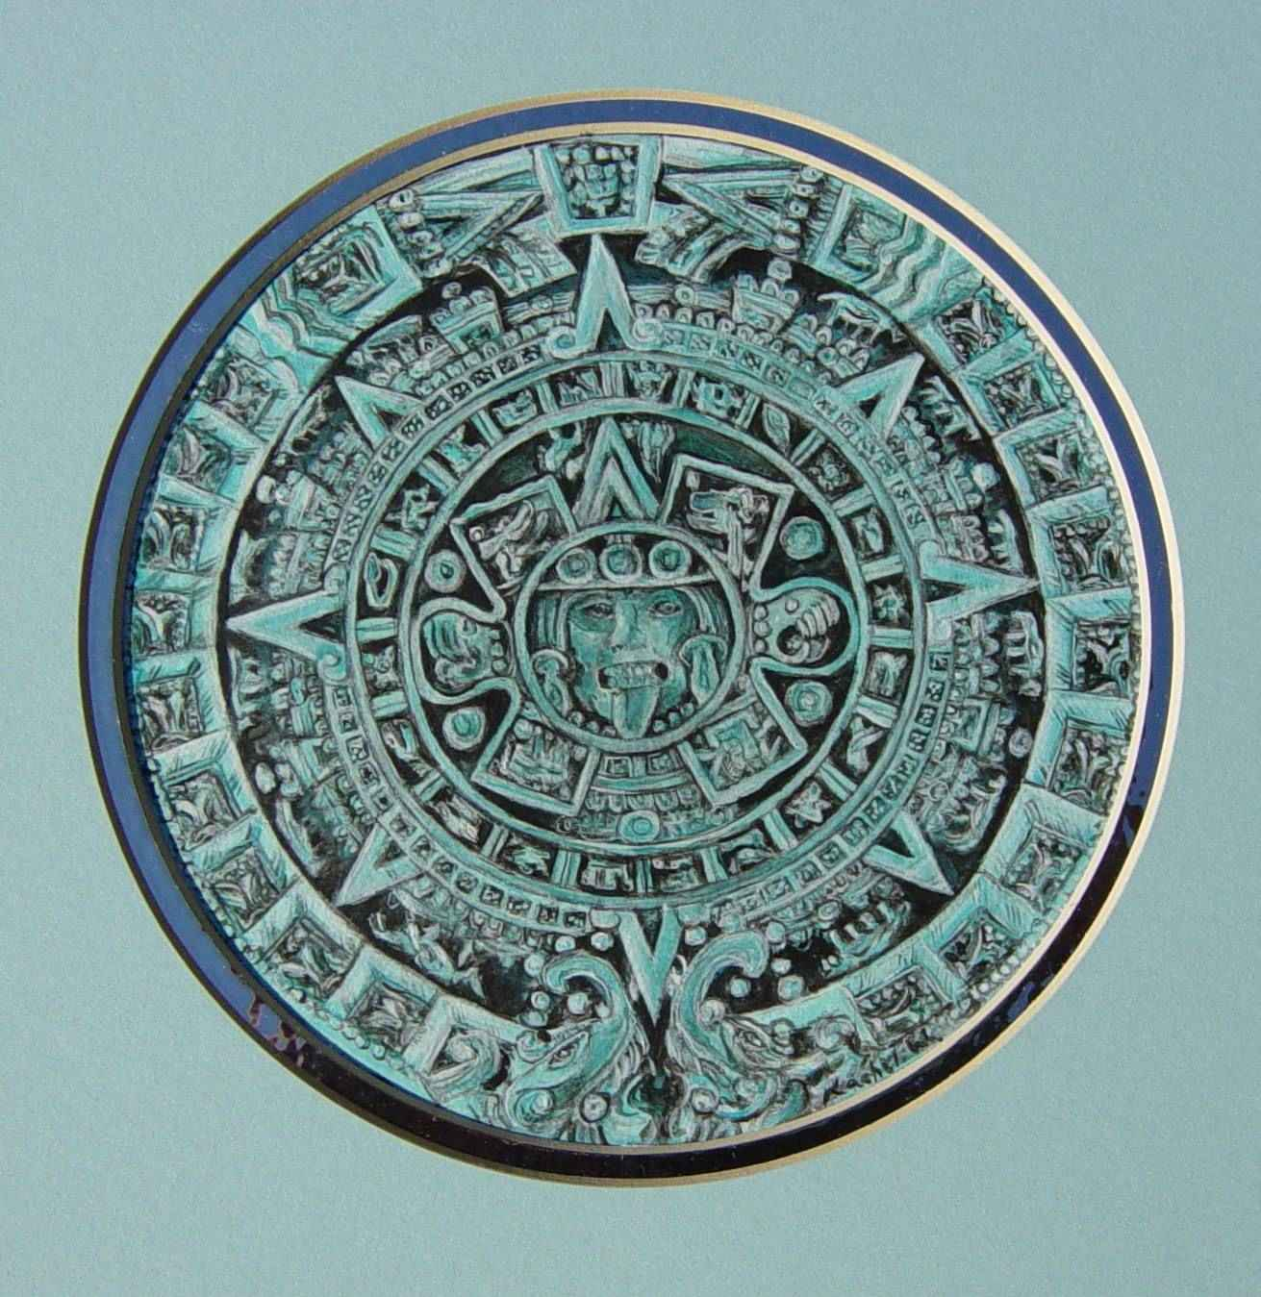

Slide 26
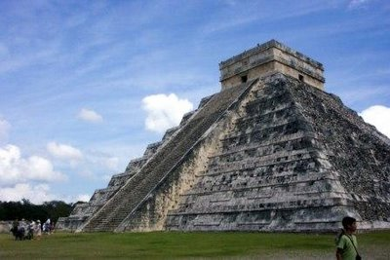

Slide 27
D. MESOAMERICAN CULTURES
3) AZTECS
-BY 1200 CE, A WARLIKE CIVILIZATION KNOWN AS THE AZTECS PUSHED INTO CENTRAL MEXICO. THEY ESTABLISHED THE CAPITAL CITY OF TENOCHTITLAN, AN ELABORATE AND WELL DESIGNED CITY THAT HAD A LARGER POPULATION THAN ANY EUROPEAN CITY
-MILITARY LEADERS HELD GREAT POWER IN AZTEC SOCIETY AND ALONG WITH THE GOVERNMENT OFFICIALS AND PRIESTS MADE UP THE NOBLE CLASS.
-THE REST OF AZTEC SOCIETY CONSISTED OF THE COMMONERS AND SLAVES.
-THEY CONQUERED NEIGHBORING VILLAGES AND FORCED THE CONQUERED PEOPLE TO PAY TRIBUTE TO THEM.
-BY THE MID 1500S, THE AZTEC EMPIRE INCLUDED ALMOST 371 CITY-STATES.
-THE AZTEC CIVILIZATIONS LIKE THE OTHER MESOAMERICAN CIVILIZATIONS WERE POLYTHEISTIC.
-AZTEC RELIGIOUS RITUALS INCLUDED HUMAN SACRIFICE, USUALLY OFFERING UP CONQUERED PEOPLE AS TRIBUTE TO THE GODS.

Slide 28
D. MESOAMERICAN CULTURES
3. AZTEC ( Pg. 2)
IN 1502 CE, MONTEZUMA II WAS CROWNED EMPEROR OF THE AZTEC EMPIRE
-DURING HIS REIGN, MONTEZUMA DEMANDED MORE TRIBUTE AND HUMAN SACRIFICE FROM THE OUTLYING PROVINCES
A NUMBER OF PROVINCES REBELLED AGAINST AZTEC OPPRESSION
-THIS BEGAN A PERIOD OF UNREST AS THE AZTEC MILITARY STRUGGLED TO PUT DOWN THESE REBELLIONS

Slide 29
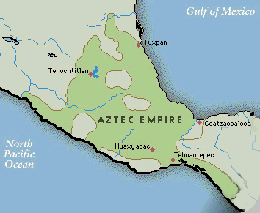

Slide 30
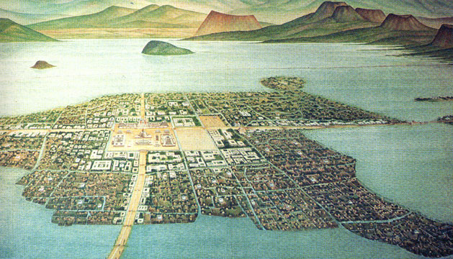

Slide 31
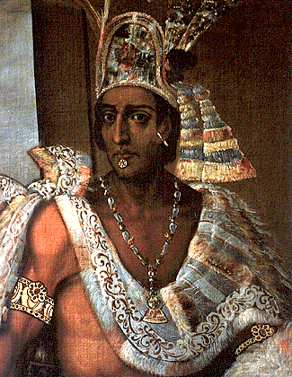

Slide 32
D. MESOAMERICAN CULTURES
3) INCAS
-ON THE PACIFIC OCEAN COAST OF SOUTH AMERICAN, THE INCAN CIVILIZATION SETTLED ALONG THE ANDES MOUNTAIN RANGE.
-AT ITS HEIGHT, THE INCAN EMPIRE STRETCHED ALMOST 2500 MILES ALONG THE ANDES MOUNTAIN RANGE THAT INCLUDED MORE THAN 12 MILLION PEOPLE.
-THE INCAS BUILT A SERIES OF ROADS AND BRIDGES LINKED THE INCAN VILLAGES TOGETHER THROUGHOUT THE ANDES.
-BECAUSE OF LIVING IN MOUNTAIN RANGES, THE INCAN
CIVILIZATION ADAPTED TO FIT THEIR NEEDS.
-THE DEVELOPED A NEW FARMING TECHNIQUE IN THE AMERICAS CALLED TERRACE FARMING, IN WHICH INCAN FARMERS CUT LEVEL FIELDS IN THE MOUNTAIN SLOPES TO INCREASE FARMING AREA.
- IN THE 1520S CE, CIVIL WAR TORE APART THE INCAN EMPIRE

Slide 33
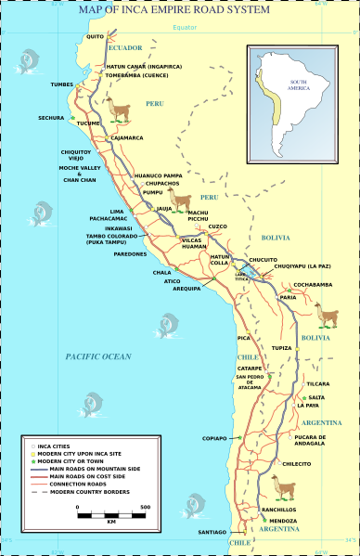

Slide 34
E. COMPETITION BETWEEN SPAIN
AND PORTUGAL
-COLUMBUS’S VOYAGES FUELED THE RIVALRY BETWEEN SPAIN AND PORTUGAL. THE KING OF PORTUGAL REJECTED THE SPANISH CLAIMS TO THE ISLANDS OF THE CARIBBEAN.
-EACH COUNTRY DISPUTED THE RIGHT OF THE OTHER TO EXPLORE THE NEW LANDS. TO KEEP PEACE BETWEEN THE TWO COUNTRIES, THE POPE ARRANGED A SETTLEMENT.
-AFTER LONG NEGOTIATIONS, THE TWO COUNTRIES SIGNED THE TREATY OF TORDESILLAS.
-THE TREATY DREW UP A LINE OF DEMARCATION NORTH AND SOUTH ACROSS THE ATLANTIC OCEAN.
-THE TREATY GAVE SPAIN THE RIGHT TO SETTLE ALL LANDS WEST OF THE LINE AND GAVE PORTUGAL ALL LANDS TO THE EAST OF THE LINE.
-THE TREATY GAVE SPAIN THE RIGHT TO CLAIM MOST OF NORTH AND SOUTH AMERICA ALTHOUGH NO ONE AT THE TIME REALIZED THE EXTENT OF THESE LANDS.

Slide 35
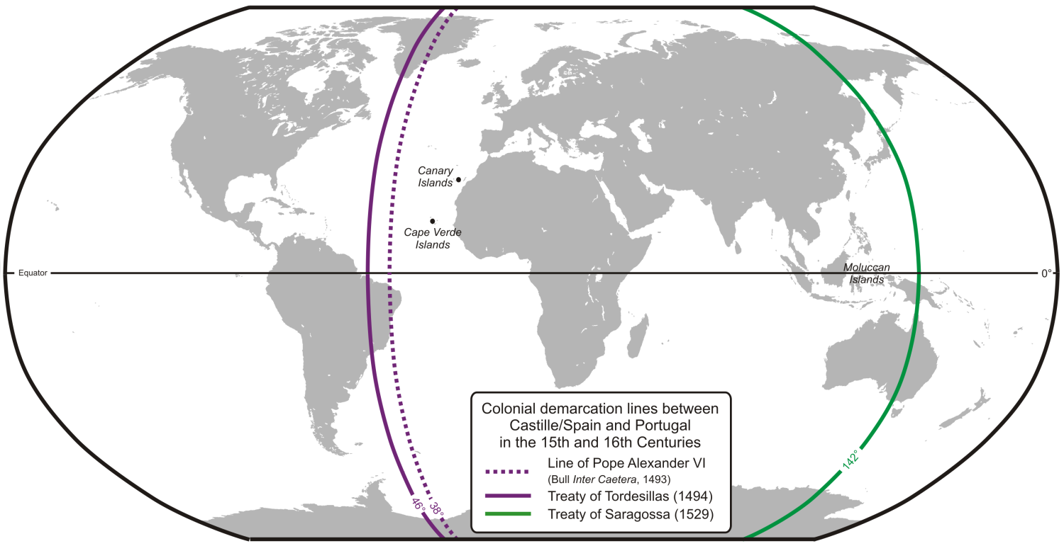

Slide 36
F. OTHER EXPEDITIONS
FURTHER VOYAGES UNVEILED THE HUGE EXTENT OF LAND THE REPRESENTED THE CONTINENTS OF NORTH AND SOUTH AMERICA.
AMERIGO VESPUCCI
-AN ITALIAN WHO REPRESENTED THE MEDICI BANK IN SPAIN, UNDERTOOK SEVERAL VOYAGES FOR SPAIN.
-HE CHARTED THE COASTLINE OF CENTRAL AMERICA AND COINED THE PHRASE “ MUNDUS NOVUS “ LATIN FOR NEW WORLD.
-IN 1507, A GERMAN MAPMAKER LABELED THE CONTINENTS AMERICA IN RECOGNITION OF AMERIGO VESPUCCI.

Slide 37
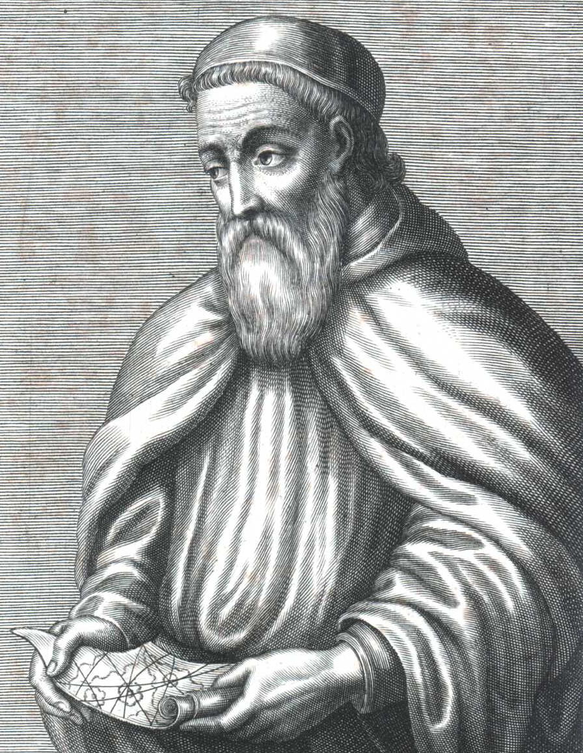

Slide 38
F. OTHER EXPEDITIONS
SPANISH EXPLORERS SOON FANNED THROUGHOUT THE CARIBBEAN SEA.
2) PONCE DE LEON
- IN 1513, PONCE DE LEON EXPLORED MODERN DAY FLORIDA.
3) VASCO DE BALBOA
-PUSHED THROUGH CENTRAL AMERICA AND DISCOVERED THE PACIFIC OCEAN.
4) FERDINAND MAGELLAN
-FIRST PERSON TO CIRCUMNAVIGATE AROUND THE WORLD
-CLAIMED THE ISLAND CHAIN OF THE PHILIPPINES
IN SOUTHEAST ASIA (NAMED AFTER PHILLIP II OF SPAIN)
-GAVE SPAIN A BASE TO ESTABLISH TRADE WITH CHINA AND SPREAD CATHOLIC TEACHING IN EAST ASIA

Slide 39
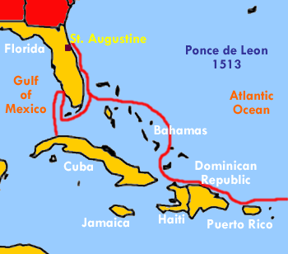
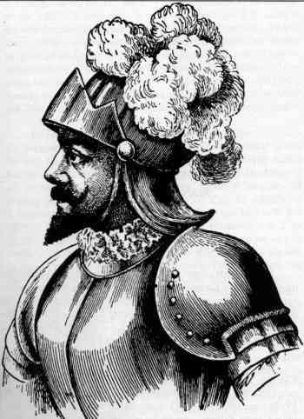

Slide 40
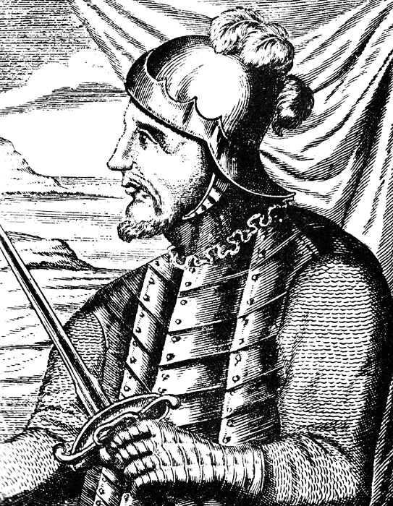
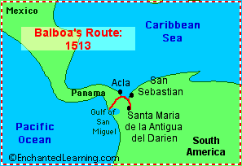

Slide 41
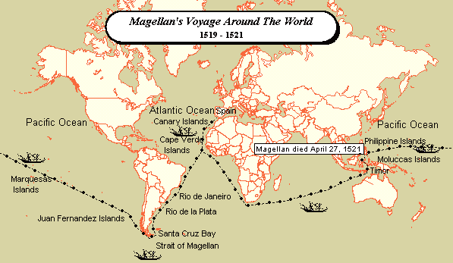

Slide 42
G. IMPERIALISM IN THE AMERICAS
EUROPEAN COUNTRIES BEGAN TO DOMINATE THE AMERICAS FROM THE 1500S TO THE 1700S
THE DOMINATION BY ONE COUNTRY OF THE POLITICAL/ECONOMIC LIFE OF ANOTHER COUNTRY IS KNOWN AS IMPERIALISM
1) SPANISH CONQUISTADORS
-THE SPANISH AND THE PORTUGUESE WERE THE FIRST IN ESTABLISHING COLONIAL EMPIRES IN THE AMERICAS.
-INSTEAD OF FINANCING EXPEDITIONS DIRECTLY, SPANISH RULERS GRANTED CONQUISTADORS, OR CONQUERORS, THE RIGHT TO ESTABLISH OUTPOSTS IN THE AMERICAS.
- IN EXCHANGE FOR THIS RIGHT, THE CONQUISTADORS AGREED TO GIVE A PERCENTAGE OF ANY TREASURE FOUND TO THE KING.
-THUS, THE SPANISH RULERS LAUNCHED EXPEDITIONS AT LITTLE RISK OR COST TO THEMSELVES.

Slide 43
G. IMPERIALISM IN THE AMERICAS (Pg 2)
A) HERNAN CORTES
-IN 1519, HERNANDO CORTES LANDED OFF THE COAST OF MEXICO IN SEARCH OF GOLD.
-IN ORDER TO DEFEAT THE POWERFUL AZTECS THAT CONTROLLED THE AREA, CORTES ENLISTED VARIOUS NATIVE TRIBES THAT DISLIKED THE AZTECS.
-WITHIN A FEW YEARS, THE AZTEC EMPIRE CRUMBLED AND SPAIN WAS IN CONTROL.

Slide 45
G. IMPERIALISM IN THE AMERICAS (Pg 3)
B) FRANCISCO PIZARRO
-IN 1527, FRANCISCO PIZARRO LANDED ON THE PACIFIC COAST OF SOUTH AMERICA.
-PIZARRO LED AN ADVANCEMENT TO TAKE OVER LANDS OF THE INCAN CIVILIZATION.
-BY 1535, PIZARRO CONTROLLED MUCH OF LAND CONTROLLED BY THE INCAS.

Slide 47
G. IMPERIALISM IN THE AMERICAS (Pg 3)
2. SPANISH VICTORY
-THERE WERE VARIOUS REASONS WHY THE SPANISH DEFEATED THE NATIVES QUITE RAPIDLY
A. THE SPANISH HAD BETTER WEAPONS (GUNS AND CANNONS)
B. THE SPANISH HAD HORSES THAT HELPED MOVE ARMIES RAPIDLY, ALSO THE NATIVES HAD NEVER SEEN HORSES AND BELIEVED THE SPANISH THAT WERE RIDING THEM WERE GODS
C. DISEASE PLAYED A HUGE ROLE IN THE SPANISH VICTORIES, THE NATIVES HAD NO IMMUNITY TO MANY DISEASES CARRIED BY THE EUROPEANS
D. MANY NATIVE TRIBES DISLIKES THE AZTECS AND INCAS AND HAD HELPED THE SPANISH CONQUISTADORS

Slide 48
H. THE SPANISH EMPIRE
-WITHIN 15 YEARS, TWO OF THE MOST POWERFUL EMPIRES IN THE AMERICAS, THE AZTECS AND THE INCAS HAD FALLEN TO THE SPANISH CONQUISTADORS
THE SPANISH BEGAN SETTING UP A STRONG CENTRALIZED GOVERNMENT IN THE AMERICAS THAT WOULD LAST FOR NEARLY 300 YEARS.
-THE LANDS WERE DIVIDED INTO PROVINCES, EACH RULED BY A VICEROY.
-THE SPANISH KING ALSO ESTABLISHED THE COUNCIL OF THE INDIES THAT MADE ALL THE LAWS FOR THE COLONIES.
-IN THE EARLY 1500S, CONQUISTADORS, SETTLERS AND CHRISTIAN MISSIONARIES FLOCKED TO THE SPANISH COLONIES.

Slide 49
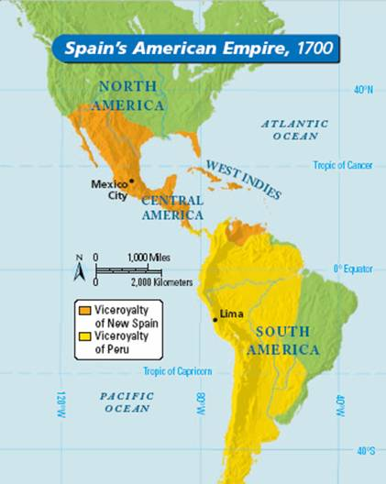

Slide 50
I. SPANISH RULE
-THE SPANISH GOVERNMENT GRANTED SETTLERS ENCOMIENDAS, OR RIGHTS TO DEMAND TAXES OR LABOR FROM THE NATIVES LIVING ON THE LAND.
-THESE ENCOMIENDAS DEVELOPED INTO A SYSTEM OF FORCED LABOR WHICH BOUND THE NATIVES TO THE LAND.
-MOST SETTLERS IN THE AMERICAS MADE FORTUNES BY EXPORTING CROPS AND RAW MATERIALS TO SPAIN.
-FROM THE AMERICAS, THE MAIN EXPORTS WERE SUGAR CANE AND TOBACCO. SUGAR CANE BECAME EXTREMELY PROFITABLE BECAUSE IT COULD BE REFINED INTO SUGAR, MOLASSES AND RUM.
-TO INCREASE PROFITS, SETTLERS DEVELOPED PLANTATIONS, OR LARGE ESTATES THAT WERE FARMED BY WORKERS THAT LIVED THERE.
-AT FIRST, THE SPANISH USED THE LOCAL NATIVES FOR THEIR WORKFORCE, HOWEVER CRUEL LABOR PRACTICES AND DISEASES KILLED OFF MANY OF THE NATIVES.
-AN IDEA TO INCREASE THE WORKFORCE WAS TO REPLACE THE NATIVE WORKERS WITH SLAVES FROM AFRICA BECAUSE THEY COULD WITHSTAND HARD LABOR IN THE HOT CLIMATE.
-THROUGHOUT THE YEARS, SPAIN BEGAN IMPORTING THOUSANDS OF AFRICAN SLAVES TO WORK ON THEIR PLANTATIONS.

Slide 52
J. OTHER COUNTRIES BEGAN COLONIZATION
-SPAIN’S PROFITABLE AMERICAN EMPIRE ATTRACTED THE ATTENTION OF OTHER EUROPEAN COUNTRIES
-ENGLAND, FRANCE AND THE NETHERLANDS SOON JOINED IN THE EXPLORATIONS OF THE NEW WORLD.
-DURING THE 1500’S AND 1600’S, EXPLORERS FOR THESE COUNTRIES CHARTED NORTH AMERICA IN SEARCH OF A NORTHWEST PASSAGE TO INDIA.
-EUROPEAN COUNTRIES CARRIED ABOUT A FIERCE COMPETITION TO GAIN A FOOTHOLD IN THE PROFITABLE TRADE WITH THE EAST AND IN THE NEW LANDS OF THE AMERICAS.
-THE DUTCH FORMED THE DUTCH EAST INDIA COMPANY TO FINANCE FURTHER TRADING EXPEDITIONS AND ESTABLISH COLONIES.
-THEY ATTACKED PORTUGUESE SHIPS AND TRADING STATIONS AND IN THE 1600S THE DUTCH REPLACED THE PORTUGUESE AS THE DOMINANT POWER IN EUROPEAN TRADE.
-DUE TO INCREASED TENSIONS BETWEEN THE ASIAN RULERS OVER THE TRADE, THE EUROPEANS BEGAN TO FOCUS THEIR ATTENTIONS ON THE AMERICA’S.

Slide 53
K. COLONIES IN THE AMERICAS
WHILE THE SPANISH WERE EXTABLISHING PROVINCES IN PRESENT-DAY MEXICO, CENTRAL AMERICA, FLORIDA, VARIOUS CARIBBEAN ISLANDS AND NORTHERN AND WESTERN SOUTH AMERICA, OTHER EUROPEAN COUNTRIES WERE SETTLED THE REST OF NORTH AND SOUTH AMERICA.
THE PORTUGEUSE ESTABLISHED EMPIRES ALONG THE EAST COAST OF SOUTH AMERICA.
THE FRENCH ESTABLISHED COLONIES IN PRESENT-DAY CANADA AND THE CENTRAL PART OF THE UNITED STATES.
GREAT BRITAIN ESTABLISHED COLONIES ALONG THE EAST COAST OF NORTH AMERICA.
THE DUTCH SETTLED A SMALL AREA OF LAND ON THE NORTHERN COAST OF SOUTH AMERICA AND IN SCATTERED AREAS IN NORTH AMERICA.

Slide 54
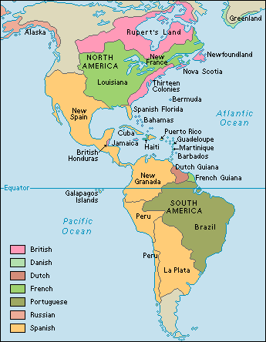

Slide 55
L. TRIANGULAR TRADE
-SLAVE TRADE ACROSS THE ATLANTIC FROM THE COASTS OF WEST AFRICA BECAME PART OF A SYSTEM OF TRADE KNOWN AS TRIANGULAR TRADE.
(1) RAW MATERIALS PRODUCED IN THE AMERICAS WERE TRANSPORTED ACROSS THE ATLANTIC OCEAN TO THE EUROPE
(2) MERCHANTS SHIPPED MANUFACTURED GOODS, WEAPONS AND RUM TO AFRICA IN EXCHANGE FOR GOLD OR SLAVES.
(3) AFRICAN SLAVES WERE THEN TRANSPORTED ACROSS THE ATLANTIC TO THE AMERICAS AS THE LABOR FORCE FOR THE PLANTATIONS.
THIS TRANSPORTATION OF SLAVES ACROSS THE ATLANTIC BECAME KNOWN AS THE MIDDLE PASSAGE.

Slide 56
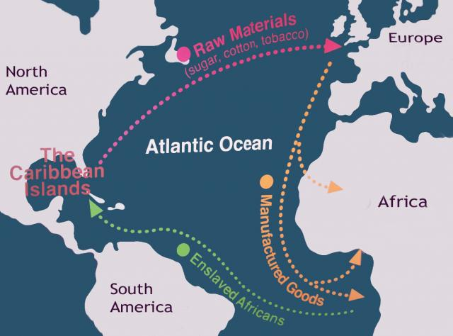

Slide 57
M. THE MIDDLE PASSAGE
-THE MIDDLE PASSAGE WAS BRUTAL AND DEGRADING. TRADERS CHAINED THE SLAVES IN THE CROWDED CARGO HOLD OF THE SHIPS. SLAVES HAD LITTLE FOOD, WATER OR SANITARY FACILITIES. MANY DIED BEFORE THEY REACHED THE AMERICAS.
-IT IS ESTIMATED THAT APPROXIMATELY 10 MILLION AFRICANS SURVIVED THE JOURNEY TO SLAVERY IN THE AMERICAS.
-THE SLAVES WERE SOLD OR TRADED FOR RAW MATERIALS TO BRING TO EUROPE TO BE USED FOR FACTORIES TO PRODUCE MANUFACTURED GOODS.

Slide 58
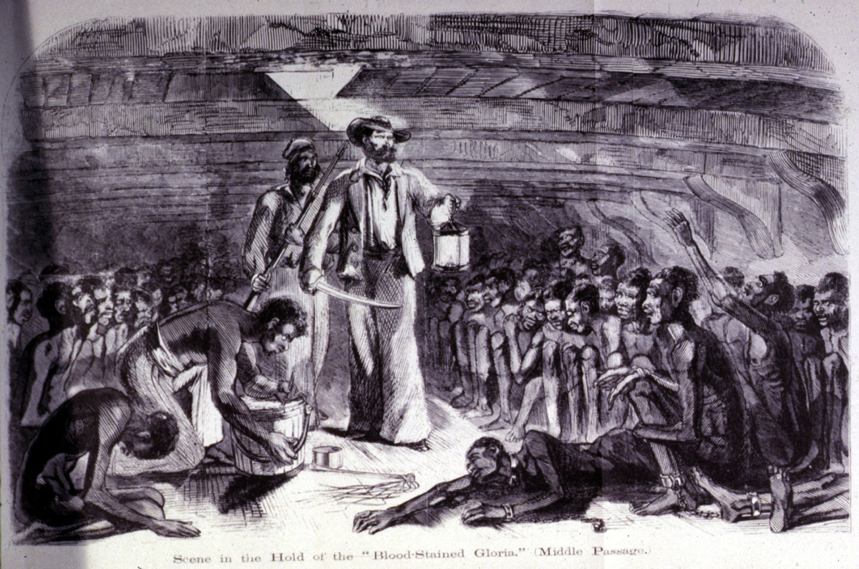

Slide 59
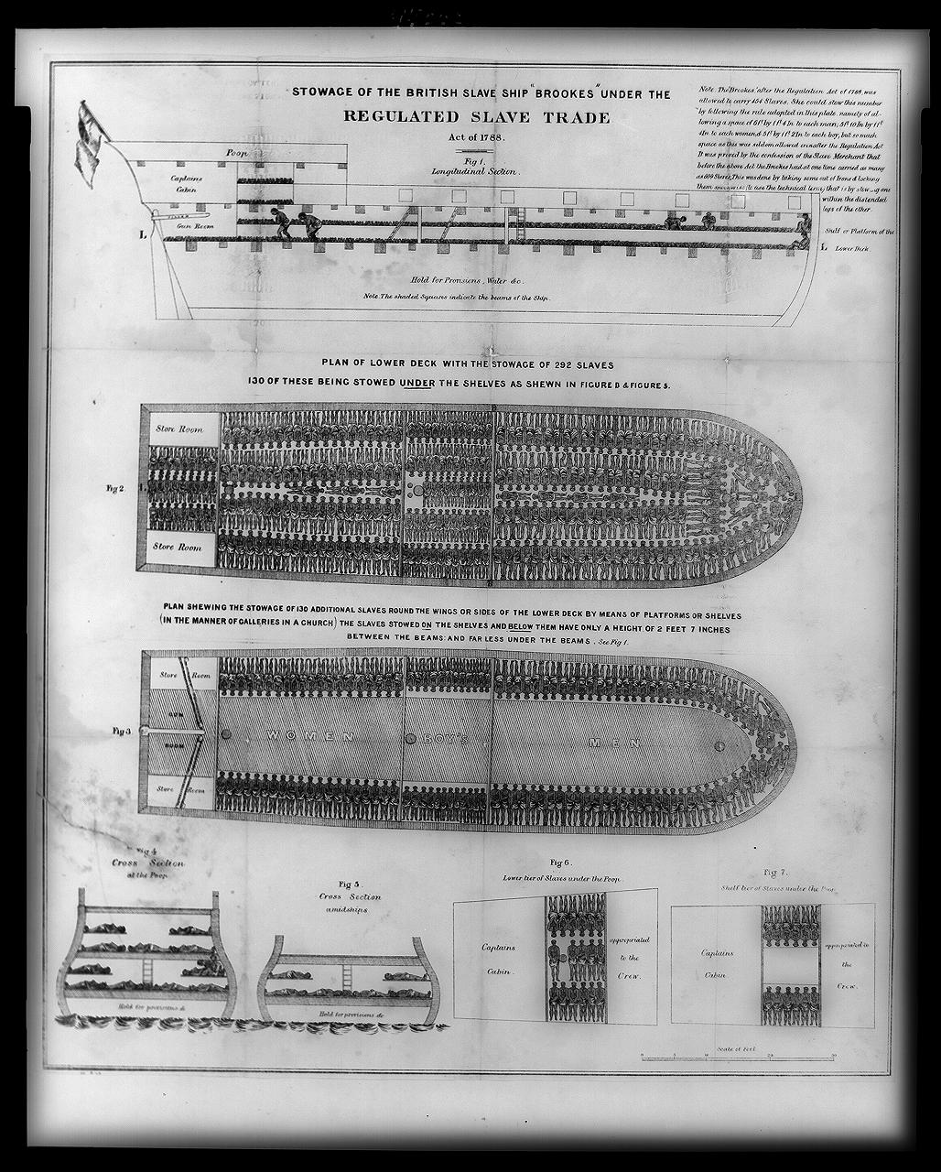

Slide 60
O. THE COLUMBIAN EXCHANGE
-THE DISCOVERY OF THE AMERICAS INTRODUCED NEW CULTURES, ANIMALS, CROPS TO EUROPE
-THIS TRANS-ATLANTIC TRADE LED TO THE EXCHANGE OF PEOPLE, PLANTS, ANIMALS, IDEAS AND TECHNOLOGY IS KNOWN AS THE COLUMBIAN EXCHANGE
-THIS EXCHANGE HAD A PROFOUND EFFECT FOR THE PEOPLE OF ASIA, THE AMERICAS, AFRICA AND EUROPE.
-CROPS SUCH AS CORN AND POTATOES WENT TO EUROPE FROM THE AMERICAS
-NEGATIVES SUCH AS DISEASE TRAVELED AROUND THE GLOBE

Slide 61
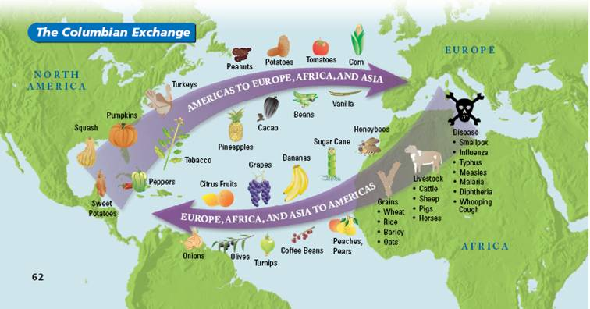

Slide 62
P. CHANGES IN BUSINESS
-THERE WERE MANY RISKS INVOLVED WITH OVERSEAS TRADE.
-MERCHANTS THAT WERE WILLING TO TAKE THESE RISKS IN SEARCH OF HIGH PROFITS WERE KNOWN AS ENTREPRENEURS.
-ENTREPRENERS DEVELOPED NEW WAYS OF BUSINESS TO REDUCE THEIR RISKS. MERCHANTS NEEDED CAPITAL, OR LARGE SUMS OF MONEY, TO INVEST IN BUYING THE NEEDED SUPPLIES FOR OVERSEAS TRADING.
-BANKS BEGAN TO ISSUE LOANS TO THESE MERCHANTS AND IN RETURN BANKS CHARGED MORE MONEY (INTEREST) ON THEIR LOANS.
-MERCHANTS ALSO DEVELOPED JOINT-STOCK COMPANIES TO FINANCE THEIR VENTURES.
-A GROUP OF MERCHANTS WOULD JOIN TOGETHER A FORM THESE COMPANIES. IN ORDER TO RAISE CAPITAL, THEY SOLD SHARES OF STOCK IN THEIR COMPANY.
-WHEN THE MERCHANT SHIPS RETURNED FROM THE AMERICAS WITH THEIR CARGO, EACH INVESTOR WOULD RECEIVE A SHARE OF PROFITS. HOWEVER, IF SOMETHING BAD HAPPENED, THE GROUP OF INVESTORS WOULD SHARE ANY LOSSES.

Slide 63
Q. MERCANTILISM
-EUROPEAN MONARCHS KNEW THAT THEIR COUNTRY’S POWER DEPENDED ON A STRONG ECONOMY.
-IN SUPPORT OF THIS RATIONALE, A NEW ECONOMIC THEORY CALLED MERCANTILISM DEVELOPED.
-ACCORDING TO MERCANTILISM, A NATION’S ECONOMIC STRENGTH DEPENDED ON INCREASING THEIR WEALTH BY EXPORTING MORE THAN THEY IMPORTED.
-COLONIES SUPPLIED THE PARENT NATION WITH RAW MATERIALS AND SERVED ITS MARKETS FOR ITS EXPORTS
-MERCANTILISTS BELIEVED MORE PROFITS COULD BE ATTAINED BY EXPORTING FINISHED MANUFACTURED GOODS RATHER THAN IN RAW MATERIALS.
- AS A RESULT, EUROPEAN COUNTRIES BEGAN TO COLONIZE THE WORLD IN SEARCH OF NEW LANDS TO PRODUCE RAW MATERIALS AND NEW MARKETS TO SELL THEIR GOODS

Slide 64
R. CHINESE EXPLORATION
-DURING THE 1400S, CHINA BEGAN EXPLORING THE WORLD IN SEARCH OF NEW MARKETS TO SELL THEIR UNIQUE GOODS AND TO TRADE FOR THE GOODS OF THE WEST
-A CHINESE ADMIRAL, ZHENG HE ESTABLISHED MANY TRADE LINKS WITH COMMERCE CENTERS FROM SOUTHEAST ASIA AND EASTERN AFRICA
-ZHENG HE HAD 40 TO 300 SHIPS SAILING IN HIS SEVERAL VOYAGES.
-THESE SHIPS SAILED FROM PORT TO PORT ALONG THE INDIAN OCEAN.
-AFTER ZHENG HE’S DEATH IN 1433, THE CHINESE EMPEROR BANNED TRADE AND EXPLORATION FOR CULTURAL AND SOCIAL REASONS.
- THE EMPEROR WANTED TO LIMIT CONTACT WITH FOREIGN INFLUENCES TO PRESERVE ANCIENT TRADITIONS.

Slide 65
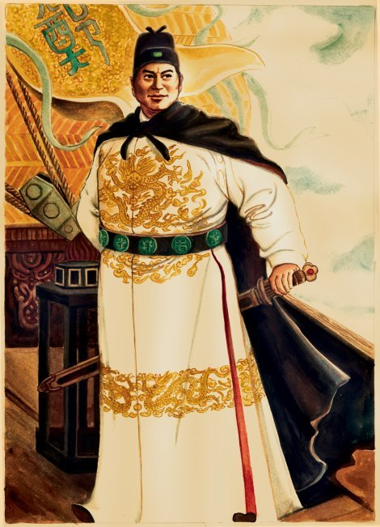

Slide 66
